Slide 1

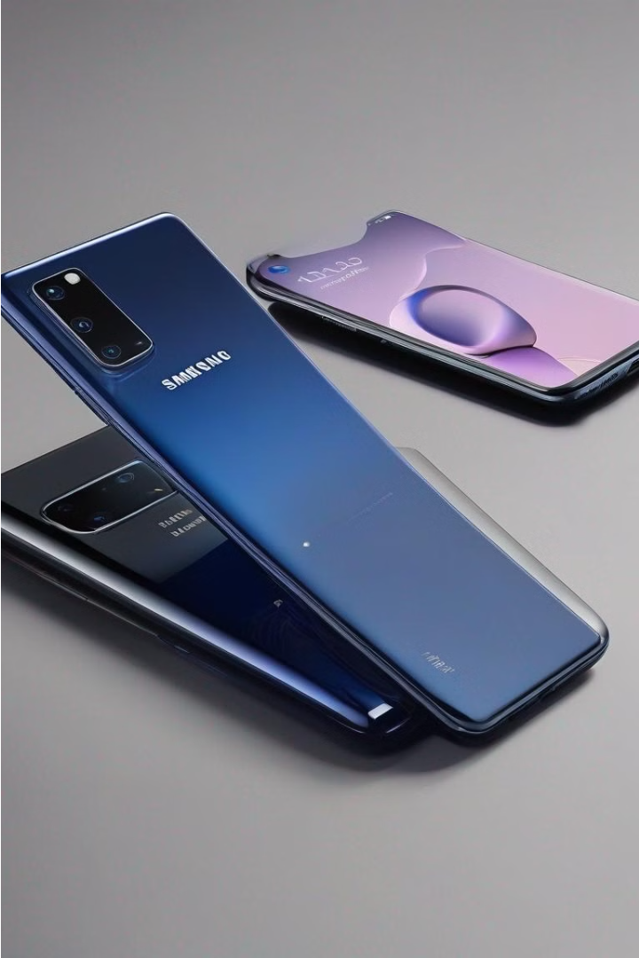
Samsung vs. Apple
When it comes to the smartphone market, the rivalry between Samsung and Apple has been intense. Both companies offer high-quality devices with cutting-edge technology, but there are key differences that set them apart. In my opinion, Samsung is better for the reasons next»»»»»

Slide 2

Key features that make Samsung better than Apple
Customization
Innovation
Value
Samsung devices offer a higher degree of customization, allowing users to personalize their experience with a wide range of software and hardware options.
Samsung has consistently been at the forefront of smartphone innovation, often introducing groundbreaking features before Apple.
Samsung's flagship devices generally offer more value for money compared to their Apple counterparts, with similar or even superior features at a lower price point.

